Slide 1

An Agentic System for Stock Recommendations
AC-215/CSCI E-115 Falls 2025
Team : Stock Buster
Members : Sirisom Pranivong, Seraphim Eilken,
Majid Uppal, Mahmood Masqati

Slide 2
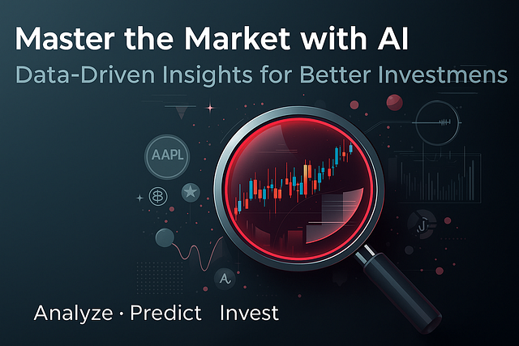
Problem Statement & Proposed Solution
Solution & Technical Architecture
Quantamental Model Pipeline
Live Demo of the Application
Challenges Faced & Solutions Implemented
Team Stock Busters | Harvard CSCI-E 115 / AC215 | December 2025

Slide 3

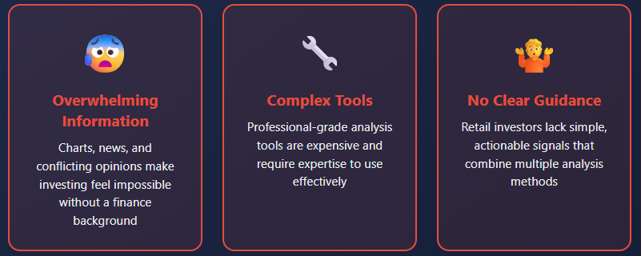
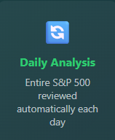
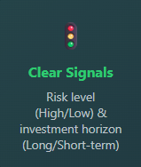
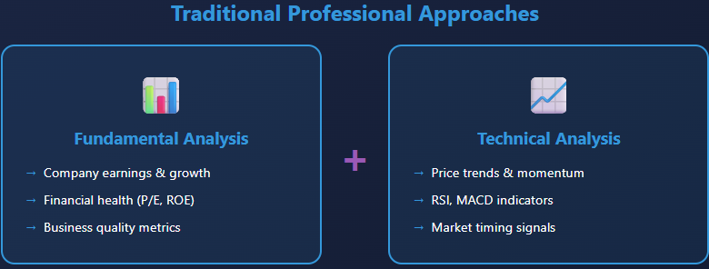
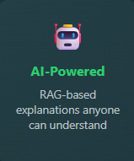

“The Challenge & Our Solution”
Team Stock Busters | Harvard CSCI-E 115 / AC215 | December 2025

Slide 4
Solution Architecture and Key Components
User preference collection bot
Stock Recommender
Stocks Report
Finance Data Pipeline
Stock Details
User
LLM with RAG
ML Models
Finance RAG
Team Stock Busters | Harvard CSCI-E 115 / AC215 | December 2025

Slide 5




Technical Architecture and Key Components
Process
Develop App
AI/ML Tasks
Chat Bot
Execution
Human Interactions
CLI + Automation
Human Interactions
Interactive Notebooks
ML Pipeline
Frontend (NGINX)
Notebooks
Data Collector
Data Processor
StockBusters
Model Training
Model Deploy
HTTP / HTTPS
HTTP / HTTPS
HTTPS
Backend
LLM (as a Service) / Agents
Gemini
API Service
State
Protocol specific
Data Store
GCP Bucket
Postgres
Knowledge Base
ChromaDB
Source Control
Artifact Registry
Team Stock Busters | Harvard CSCI-E 115 / AC215 | December 2025

Slide 6
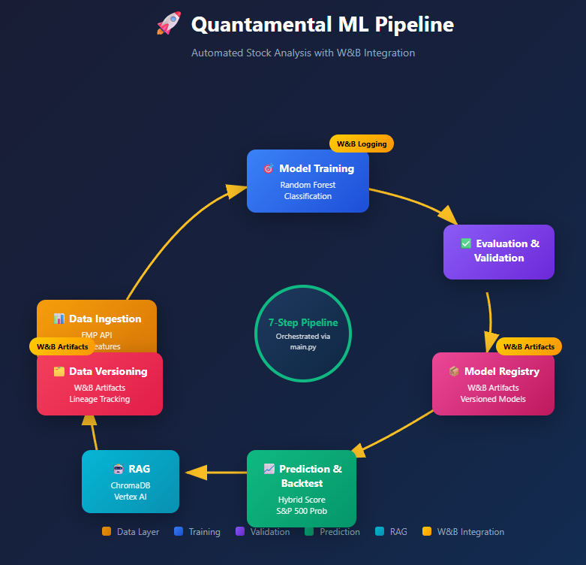
Quantamental Model Pipeline
Team Stock Busters | Harvard CSCI-E 115 / AC215 | December 2025

Slide 7
Live Demo of the Application
http://34.60.47.248.sslip.io/
Team Stock Busters | Harvard CSCI-E 115 / AC215 | December 2025

Slide 8
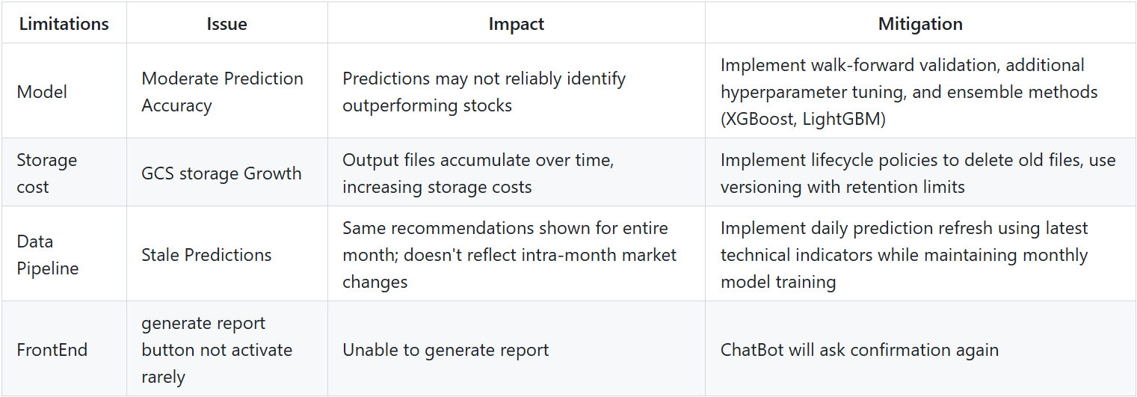
Challenges Faced & Solutions Implemented
Inconsistent response by chatbot while collecting user preference:
Solved by making the system prompts more robust
Delayed response in generating the recommendations:
Recommendation reasoning was taking a lot of time, while generating the report. The reason LLM was integrated at the final output of the model and stored reasoning to make it consistent
Model response was inconsistent based upon user preference, while using Agents equipped with RAG:
Modified the approach, instead of using system prompts, python queries were created to make the results consistent and repeatable.
Team Stock Busters | Harvard CSCI-E 115 / AC215 | December 2025

Slide 9
Thank you
Team Stock Busters | Harvard CSCI-E 115 / AC215 | December 2025

